Slide 1

Add quote or statement here
- Name Last
Eco Sync

Slide 2
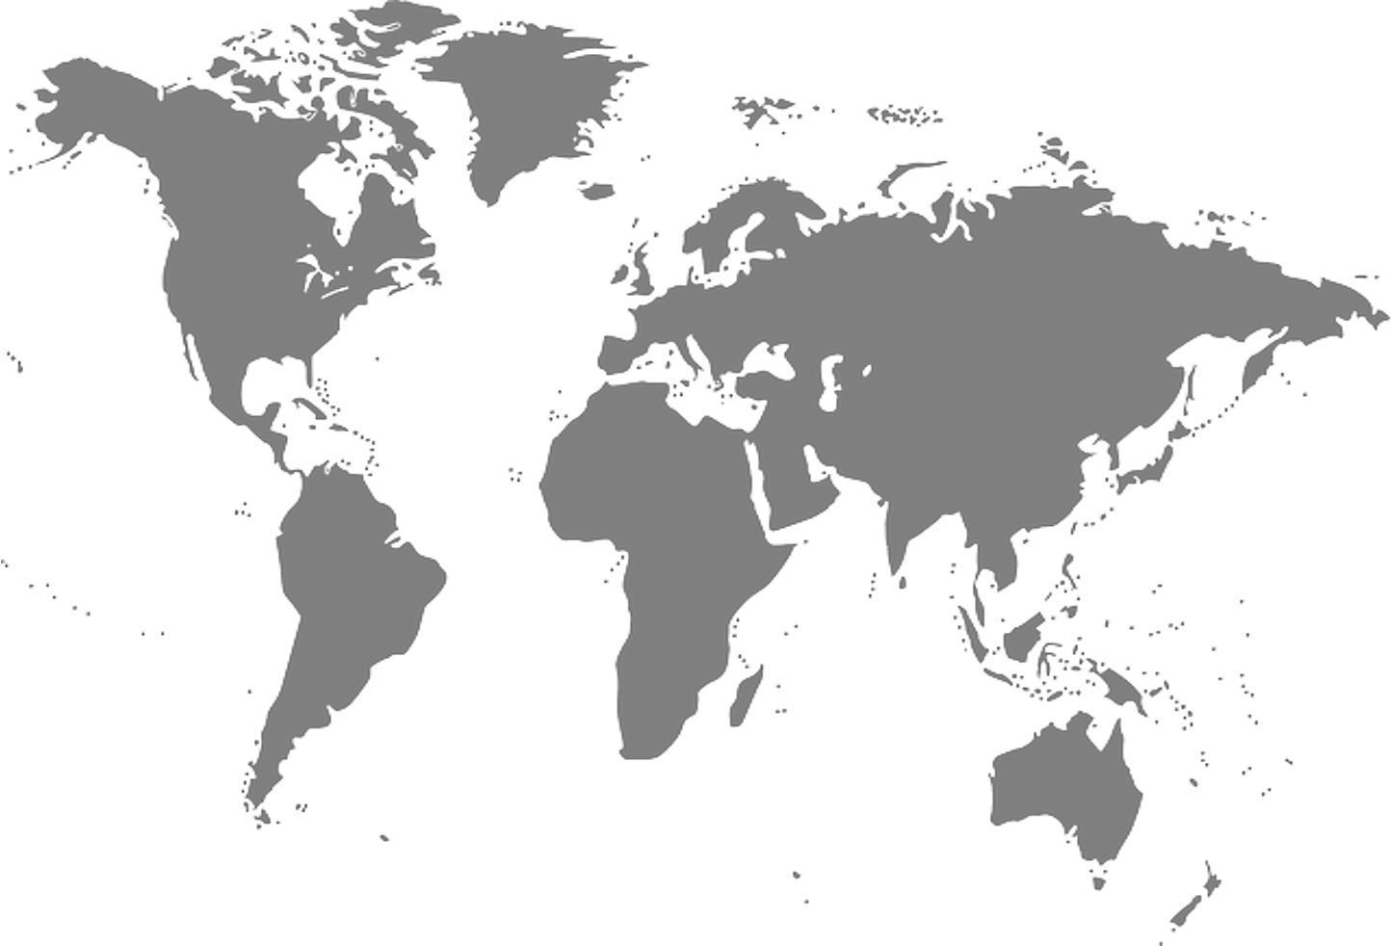

Eco-Sync – Team Intro
Kyndryl
Pedro Soares
Adrianna Kocyba-Kostecka
Amani Gaddamedi
Praveen Kumar Madhava Rao
Dominika Fargasova
Sasikala Palanisamy
Chandan Bhat
Vidyasree Bharathwaj
BhavyaShree Mucherla

Slide 3
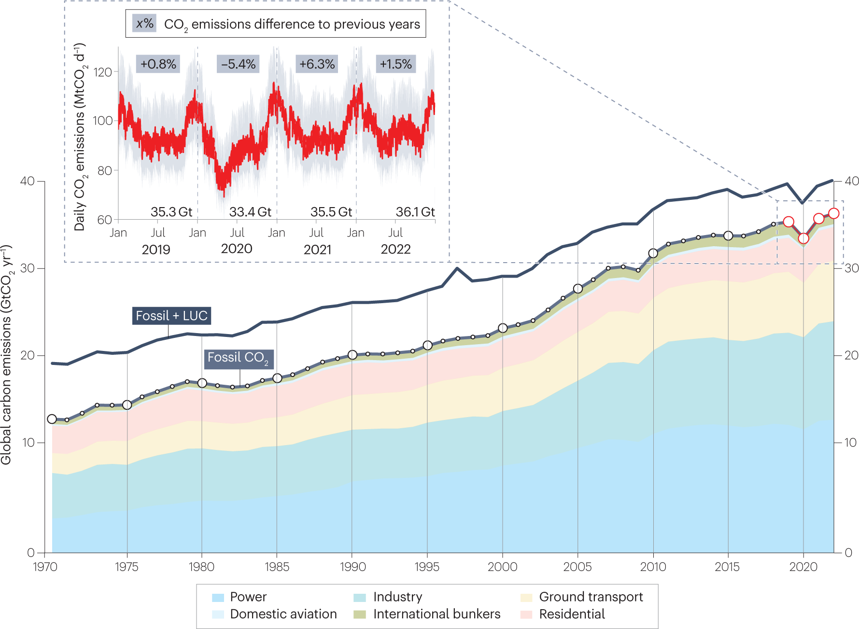
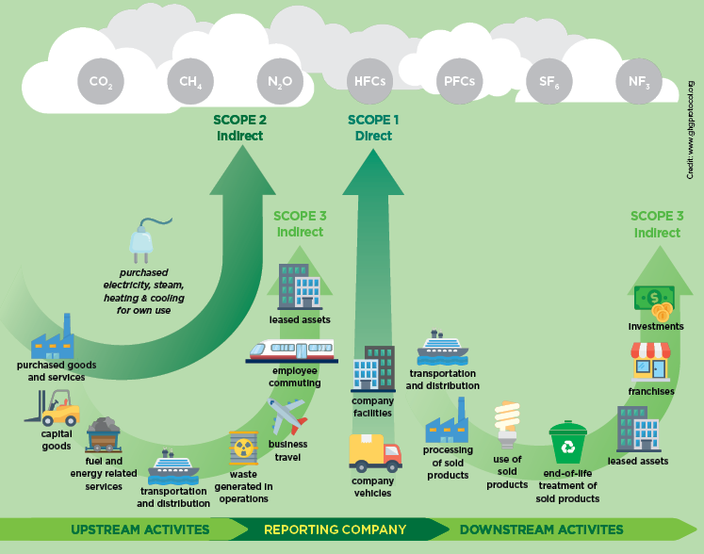
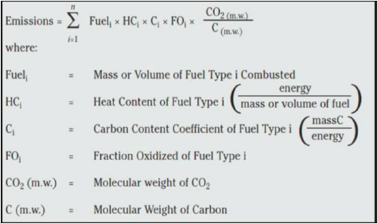
ESG and Carbon Footprint
Ref: - UCT carbon footprint report 2018 | UCT News

Slide 4





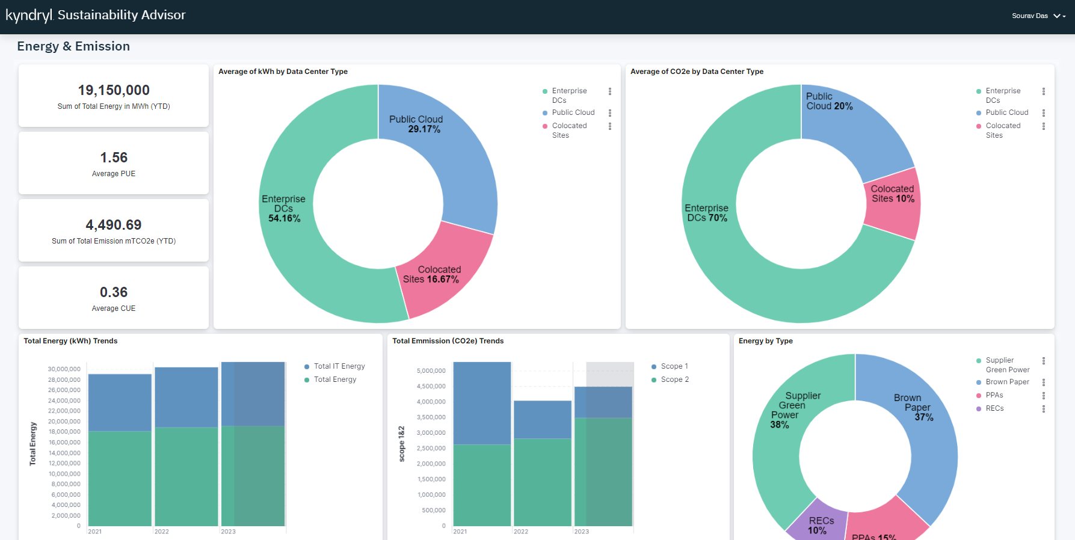
Helps with ESG Score for Individuals / Employees
Eco-Sync – An Overview
ECO-Sync
?????
How am I Environmentally/ Socially responsible ??
Sustainability Advisor
Green IT & Sustainability
Collect/ Measure sustainability Metrics
Energy usage
GHG emission
Water usage, etc.,
Provide Sustainability Reports
Analyze
and recommend

Slide 5
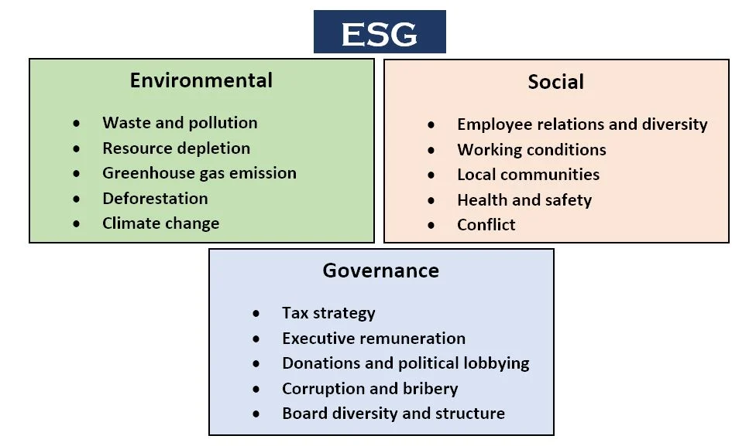
Eco-Sync
GreenSpark Theme 2:
A common Plug & Play framework that collects the ESG metrics
→ from multi-varied technological and business environment
→ to provide the ESG report, Predictive insights and
implementable advice to enhance ESG investment / Score.
A common pluggable framework to be able to pull the ESG information from different 3rd party technologies ( VMware, hyperscalers, etc..) into common data lake ( Bridge) and make it available for insights.
Problem Statement:
ESG Metrics (Environmental, Social & Governance)
Data Privacy
Data Ownership
Potential Misuse
Hence willingness to share data
Eco-Sync :
Self-Sovereign Identity (SSI)
Granular control over their data
Enriched Trust & Transparency
AI Powered Anonymization
k-anonymity
Differential privacy
Immutable Data transaction
BlockChain
Homomorphic encryption

Slide 6


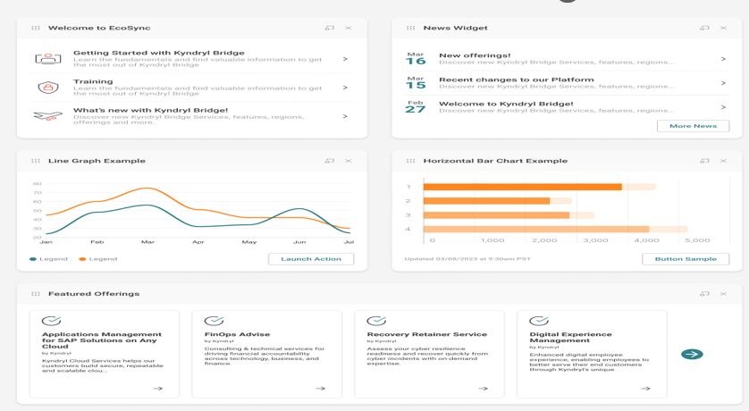





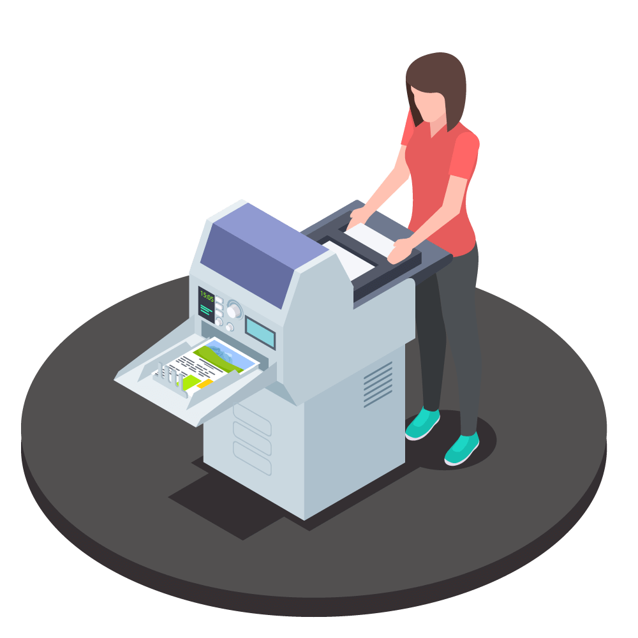


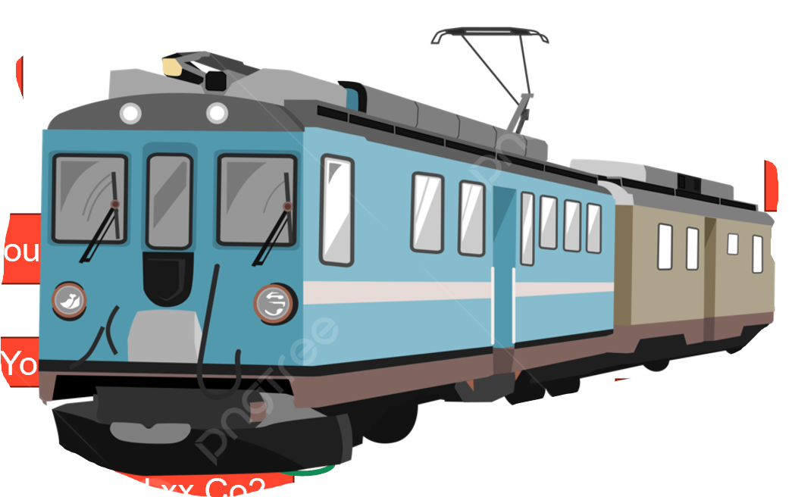


Collective contribution towards Net-Zero Statement (Save Earth)
For the Enterprise to achieve Goal of Net-Zero
Enterprise Organizations motivates their Employees to support Net-Zero Goal
Recognize Green Stars
Reward Points
Recognitions
Badges
Eco-Sync
Organization’s Dashboard
You saved xx Co2
Eco-buddy
Eco-Sync Provides Implementable Advice to enhance and Optimize the Organizations ESG Score
1. Overall Org’s ESG Score
2. Individual Employees ESG Score
3. Top 10 Contributions for Net-Zero Goal
Eco-buddy
You Contributed xx Co2
Eco-buddy
You saved xx Co2
Eco-buddy
You saved xx Co2

Slide 7






Highlights
Eco-Sync Architecture Overview
Wide Range of Technologies
Quantitative ESG Metrics
Sustainability Advisor
Various hosting Platforms
Empowered Individuals: Individuals like Anna control their data and choose what they share, fostering trust and participation in ESG initiatives.
Enhanced Data Security: AI-powered anonymization techniques minimize the risk of data breaches and misuse.
Improved Transparency: Clear audit trails and granular access controls ensure transparency in data handling practices.
Richer ESG Data Insights: Anonymized data from various sources empowers companies to gain deeper insights into their ESG performance and identify opportunities for improvement.
Anonymized thro k-anonymity
Immutable Txn thro Blockchain
Usage patterns / Utilization trends
Cognitive Load Manager
Eco-Sync Data Collection Framework
Data Aggregation & Correlation
Analytic Engine
Choice of Ent Apps
Various Industry Verticals
Insights & Predictions
Data Pipeline
ESG Indicators
Metric Library
Empowered by
Self-Sovereign Identity (SSI)
Eco-Buddy
Policy Engine
(Granular access Control, ESG Tagging & Data Transformation)
AI/ML
Insights with ESG report
Predictive Insights & advise
Metric Advisor
Non-technical/Non-Financial Metrics
Data Protection thro Differential Privacy
Secured Txn Homomorphic Encryption
Precise advice thro Federated Learning
Non-Tech Environmental metrics (Resource Depletion / GHG emission)
Social metrics (Diversity, Inclusion, Health & Safety )
IT Monitoring with Eco-Sync
Qualitative ESG Metrics
Customer1 Banking Industry
Customer2 Retail Industry
Customer2 Energy Sector
…
Customer n
XYZ Industry
Governance metrics (Ethics & Compliance)
7

Slide 8

Eco Sync – Theme 2
Business Value
Eco-Sync add value to Kyndryl to help our customers enrich their ESG score, providing them the insights and recommendation thus making customer’s business more sustainable.
Novelty
Eco-Sync seamlessly collects in ESG metrics from various third-party tools & technologies, unify the data for analysis and generates insights and recommendations.
Self-Sovereign identity (SSI) –
A digital Wallet enabled with distributed data storage and better data control thro Granular access permissions.
K-anonymity:
A sophisticated anonymization techniques that masks/removes personally identifiable information while preserving the data's statistical value for ESG analysis.
Feasibility
Eco-Buddy →
Collects ESG metrics from various third-party technologies via SSI Digital Wallet. This includes granular ESG tagging and access control.
Cognitive Load Manager → Performs AI powered data aggregation, correlation and analysis embracing various metrics/indicators/diverse environmental factors and made it available in Metric Library
Metric advisor →
Delivers constructive recommendations, standard insights and custom insights based on chosen indicator
Highlights
Self-Sovereign Identity
K-anonymity
Differential privacy
Homomorphic Encryption
Secured and decentralized data sharing with more granular control
Immutable data processing using Blockchain

Slide 9
Working Demo
Date

Slide 10
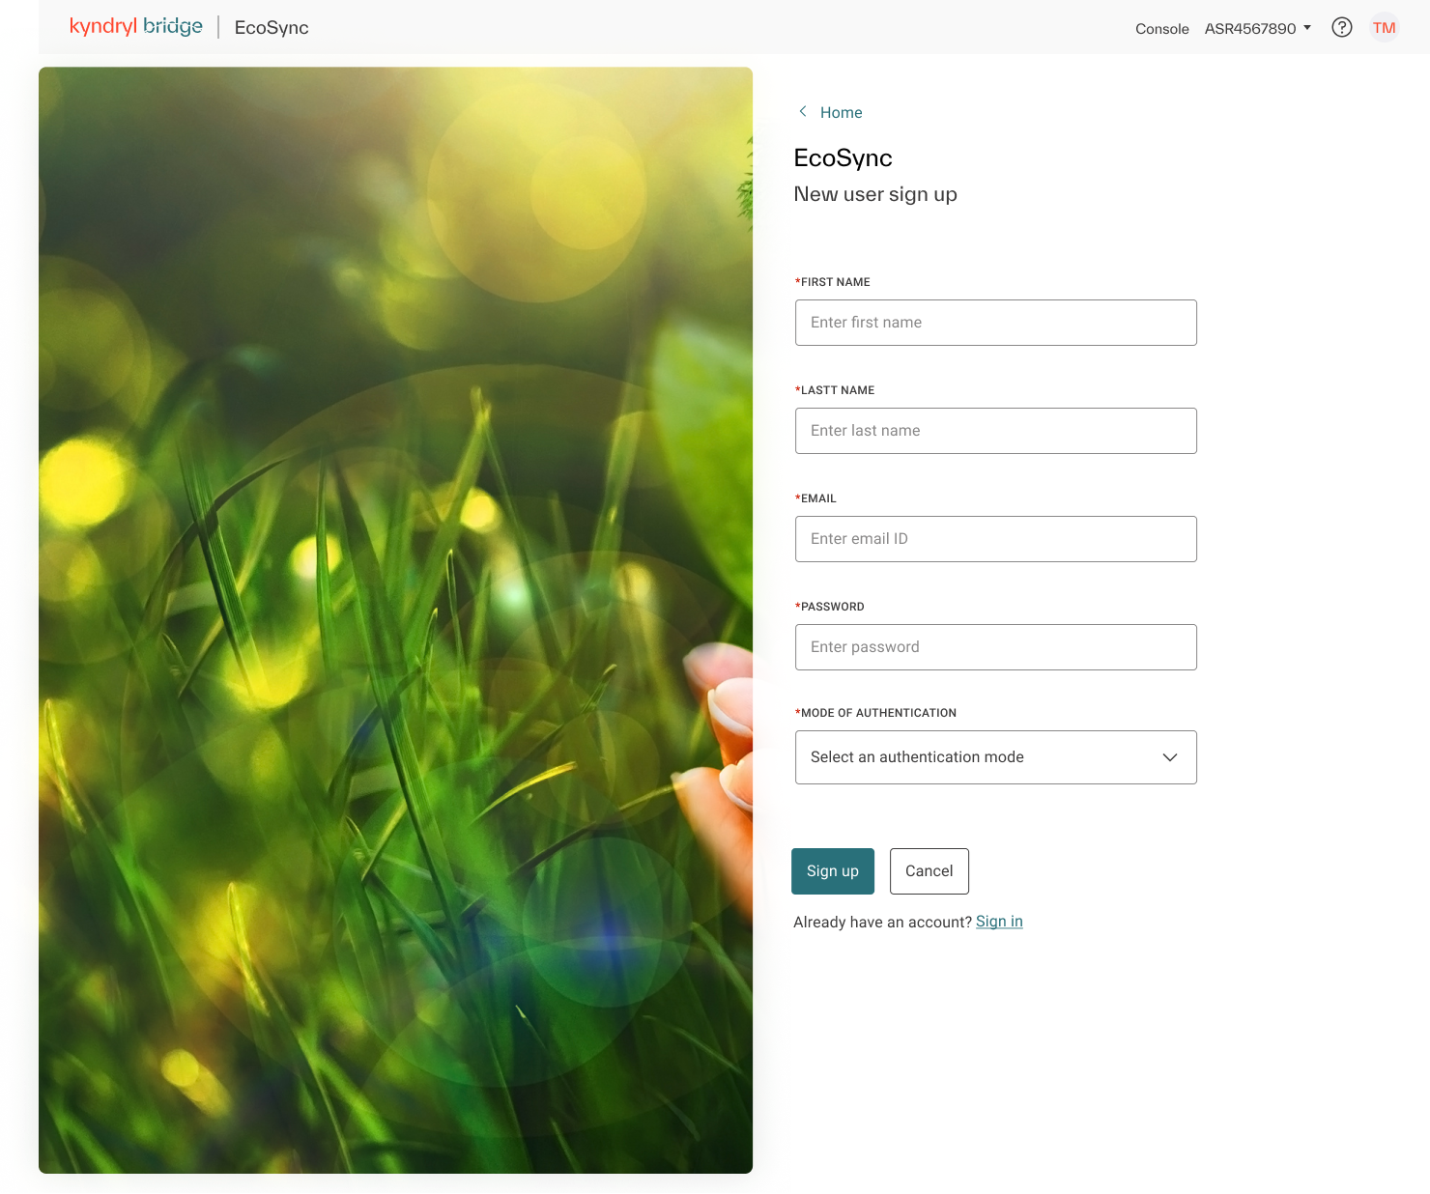
Eco-Buddy : End User Registration
Highlights
Lightweight App compatible for Mobile, Tab, Laptop and Desktop
Trusted Digital Wallet where user can have a granular control on data sharing to third-party apps

Slide 11
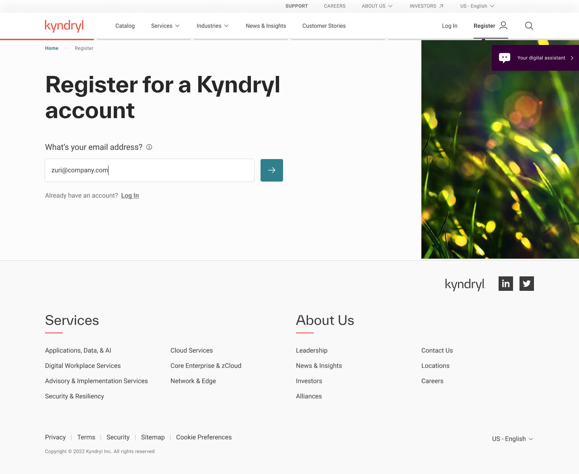
Eco-Buddy : Employee Registration through SSO

Slide 12
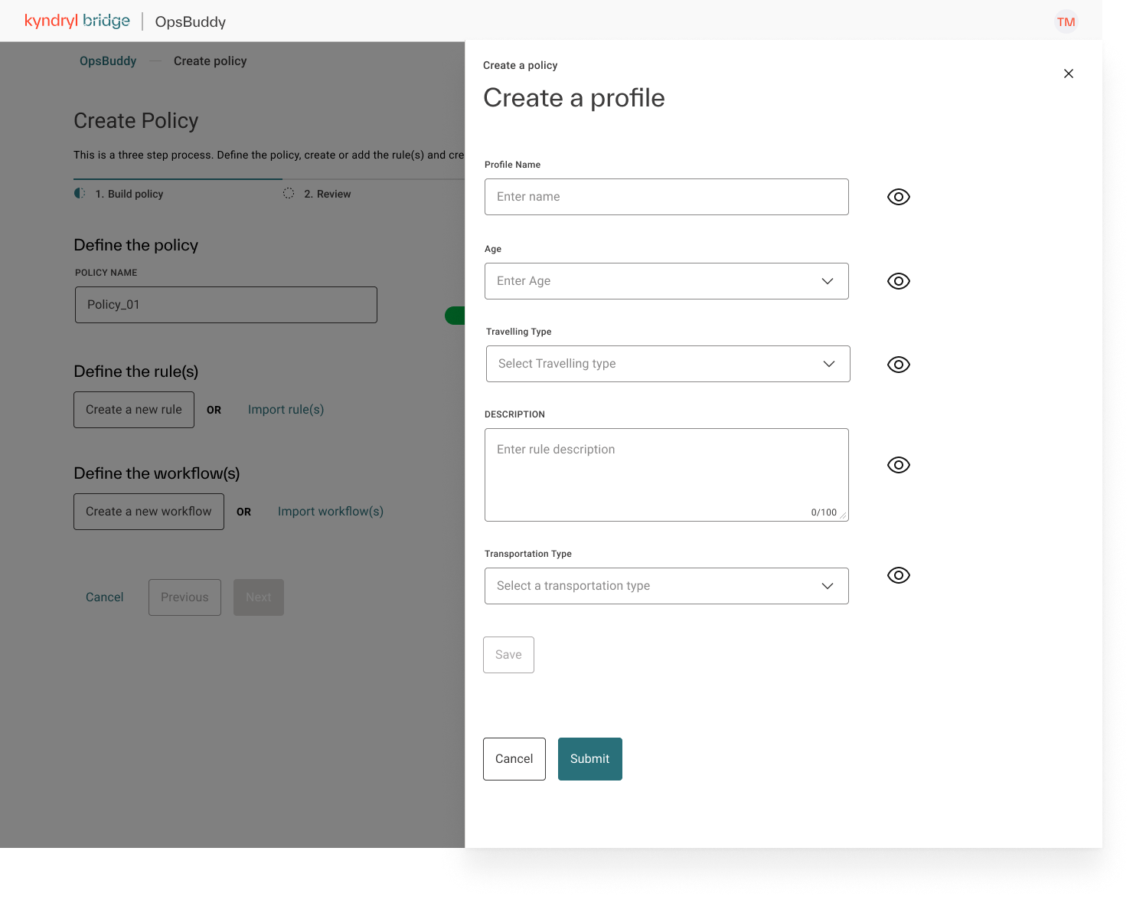
Eco-Buddy : User Profile Setup

Slide 13

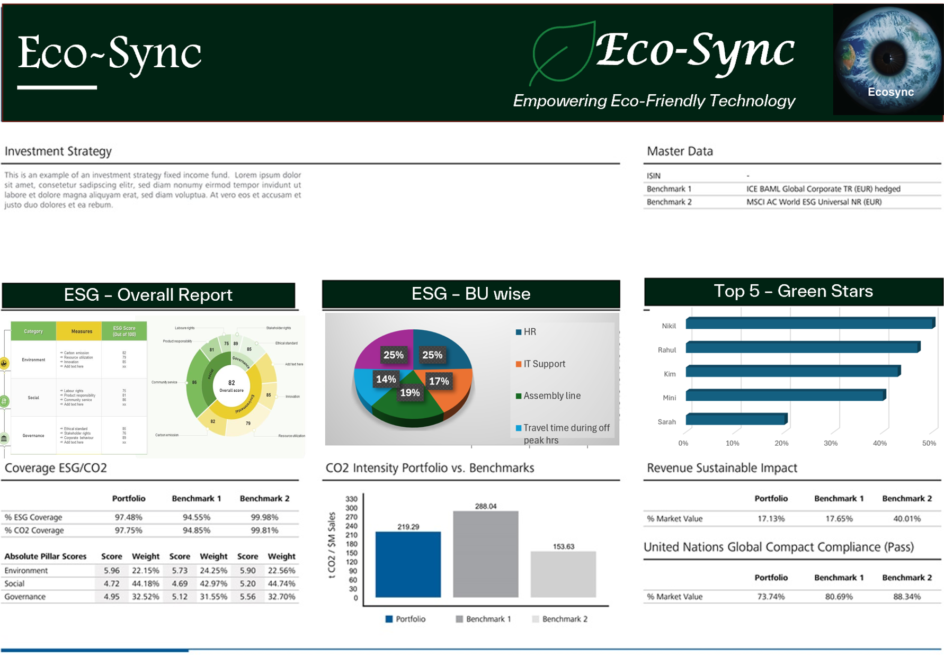

Eco-Buddy : Sample ESG Report

Slide 14
Thank You
Date

Slide 15
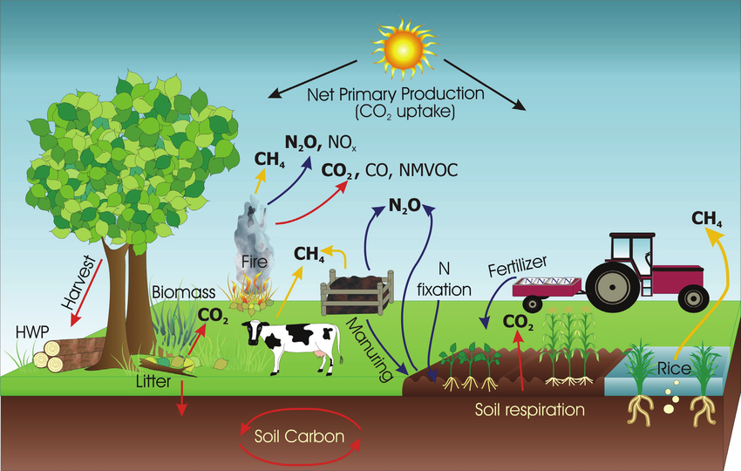
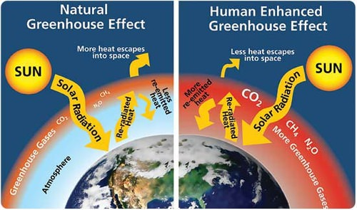
Global CO₂ emissions in 2022
Carbon Emission
– Calculation
Ref: https://www.researchgate.net/
https://flexbooks.ck12.org/

Slide 16
Eco-Sync – Theme 2
New skills
Block chain technology
Machine Learning
Data Security (Data Privacy / Sovereignty / Homomorphic Encryption)
OnDemand Custom Indicator based Insights
Team Work
Team formed with the diverse skills that includes, Architecture & Design, Visual Innovation, Governance etc.,
1. Adrianna Kocyba-Kostecka
Governance
2. Sasikala Palanisamy
Design Lead
3. Amani Gaddamedi
Design Architect
4. Vidyasree Bharathwaj
Backup Design Lead
5. Chandan Bhat
Visual Innovation Lead
6. Pedro Soares
Review & Advancement
7. BhavyaShree Mucherla
Visual innovation lead
8. Dominika Fargasova
Visual innovator
9. Praveen Kumar Madhava Rao
Visual Innovation Lead
Highlights

